Slide 1
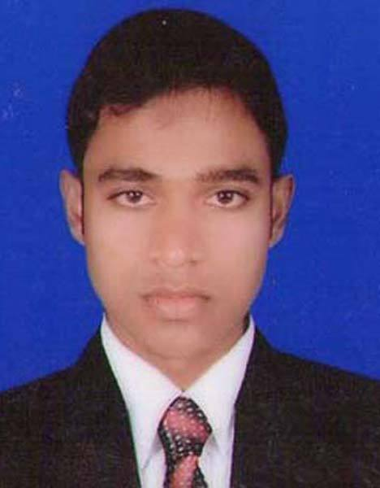
Wellcome
Abdullah Al Noman
Trainee ID: 1241478
Batch ESAD-J2EE/TCLD-A/36/01
Email: nomanidb36@gmail.com

Slide 2
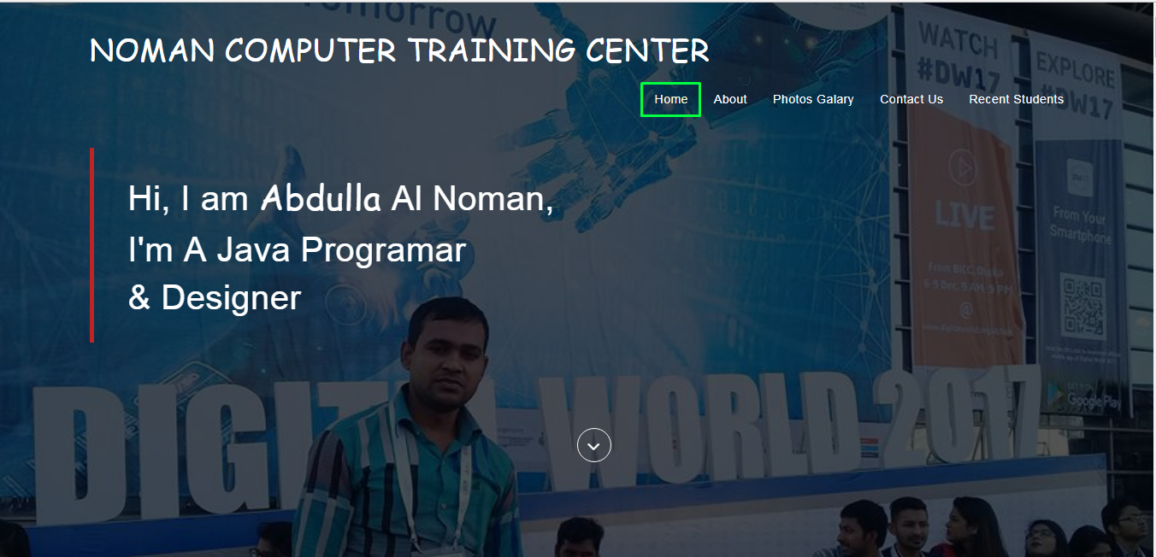
When you click on Home then display the Home page of our website or when you enter the website this home page always displayed.

Slide 3
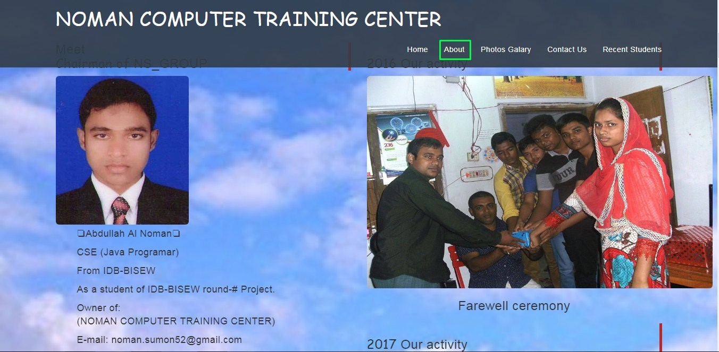
When you click on About then display the About of our information's.

Slide 4
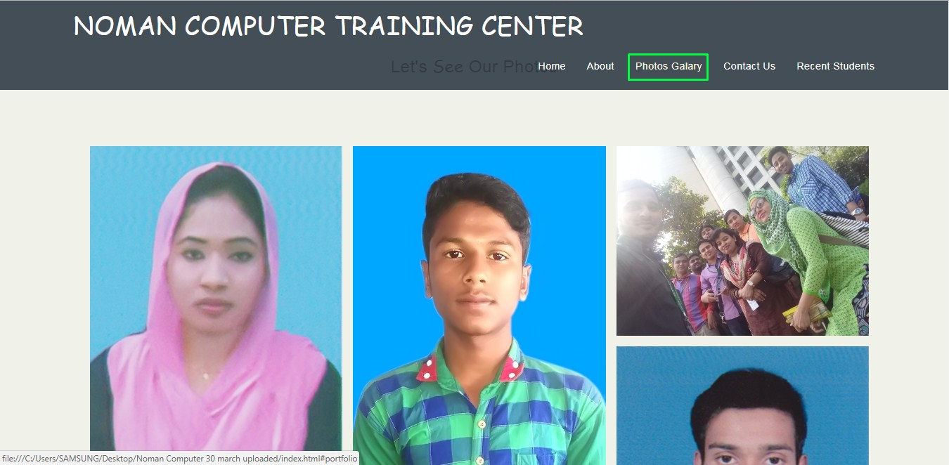
You click on Photo Gallery & visit our photos of student by scrolling.

Slide 5
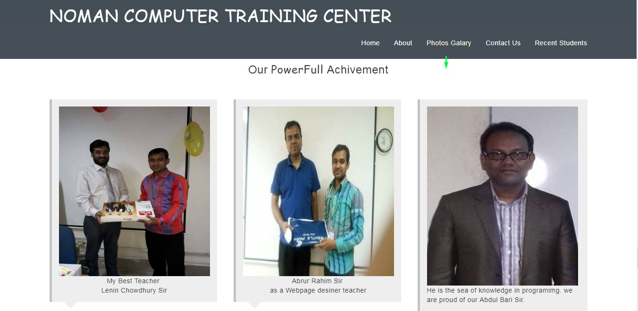
At the end of the Photo Gallery you can visit our powerful achviement.

Slide 6
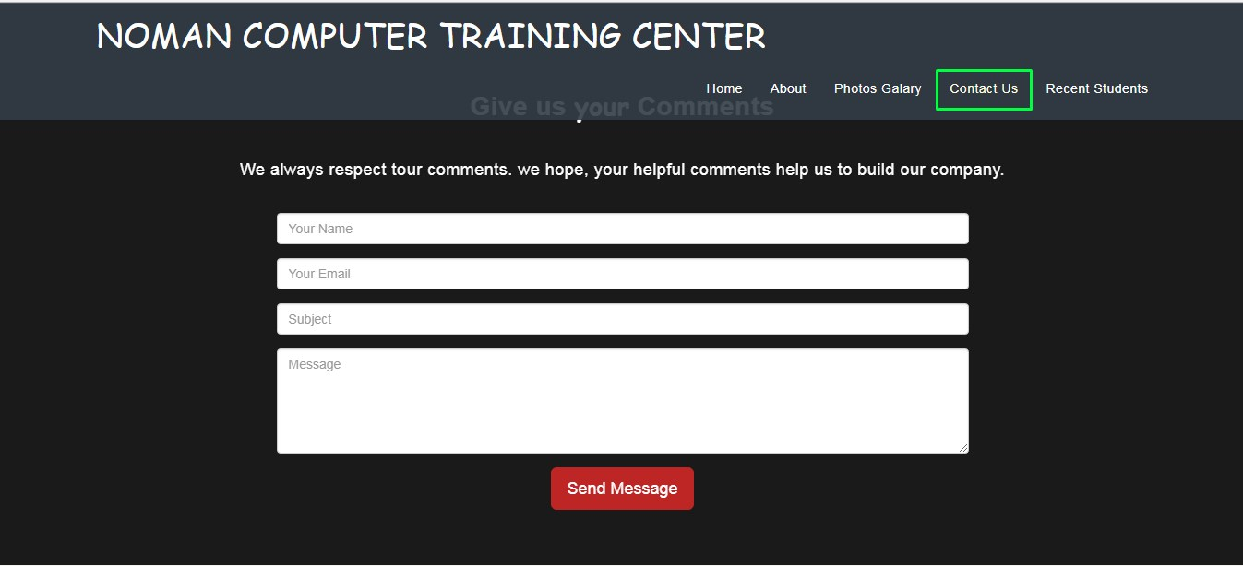
You can contact us to click on Contact us write your comments and more information to us by helpful

Slide 7
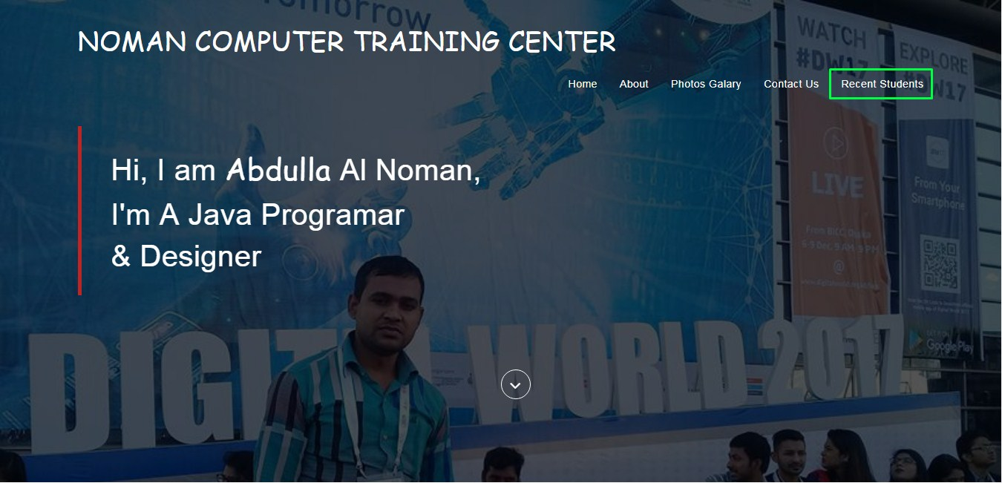
You see the recent student of our institute on click Recent Students to visit our photos of student by scrolling with another page.

Slide 8
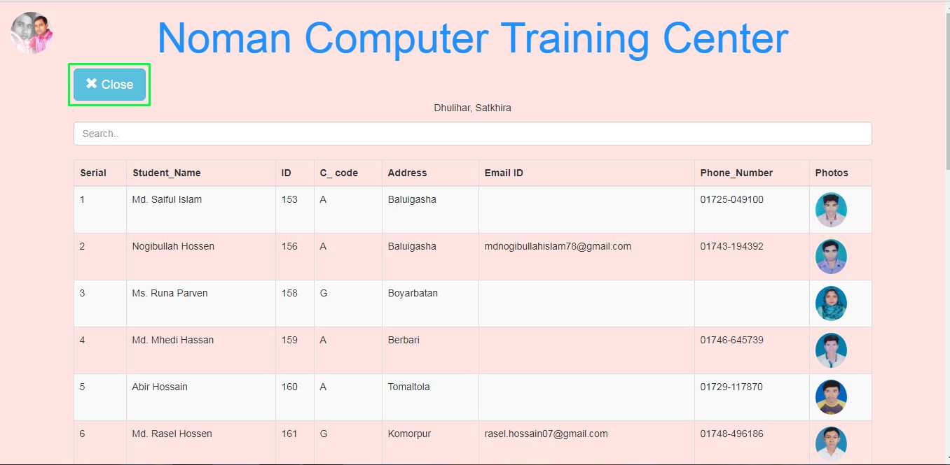
You can search here by name, ID, or inex number here. visit more student by scrolling. When you click the close button than to go to home page.

Slide 9
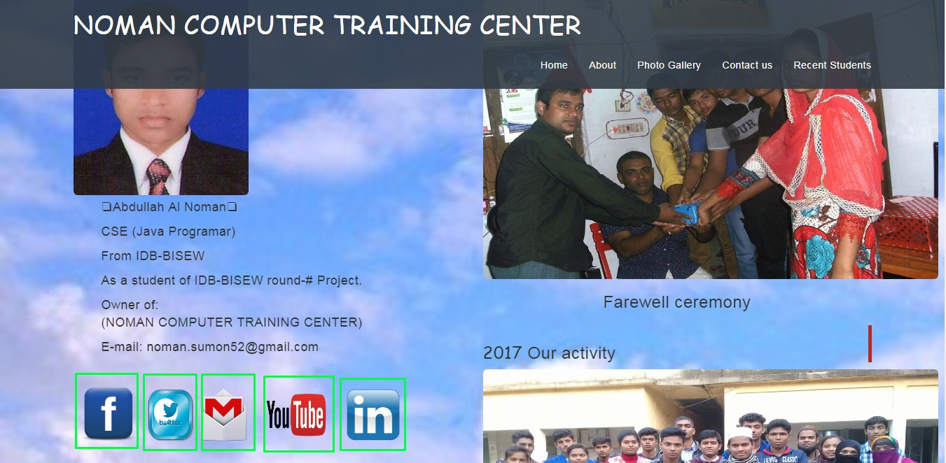
You click to Facebook, Twitter, Gmail, YouTube etc to visit of activities.

Slide 10
For visit our Wavesite.
Thank you Sir

